Slide 1


Don’t @ me: gauging retail sentiment through twitter
Filipp Krasovsky, University of San Diego MSDS ‘22

Slide 2


Uncertainty is expensive.
What you believe your customers think
Appropriate market strategy | Churn, revenue loss, suboptimal retention
Excess marketing campaigns, rewards, ads | Appropriate market strategy
What your customers think

Slide 3
so is bad customer service.
Discount/reward given, customer stays in funnel
Customer expresses dissatisfaction
Message lost in transmission, customer churns

Slide 4

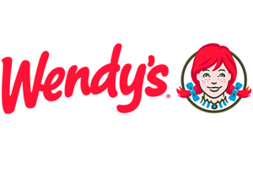

So is missing out on virality.

Slide 5
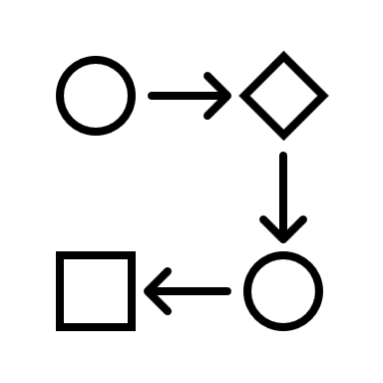
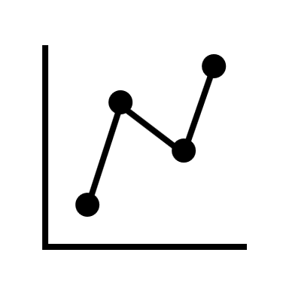

Let sentiment analysis fill the gap.
Adjust marketing & service strategy
Analyze brand perception
Aggregate Twitter data

Slide 6





what we do.
Sentiment modeling
Social Media Data Mining
Real-time sentiment analysis
Social media dashboard
marketing & advertising prescriptions
What you get.

Slide 7



What you’ll see.
More customer
volume
Quality customer
service
Budget optimization

Slide 8
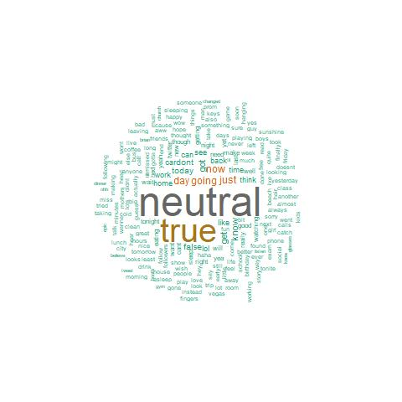
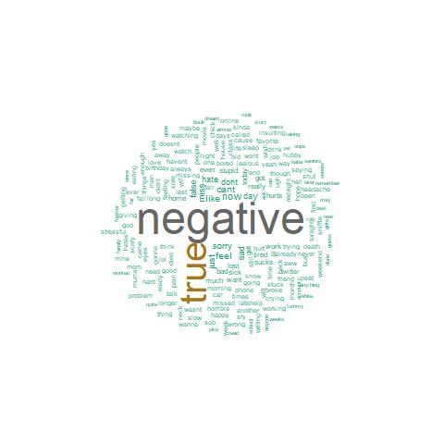
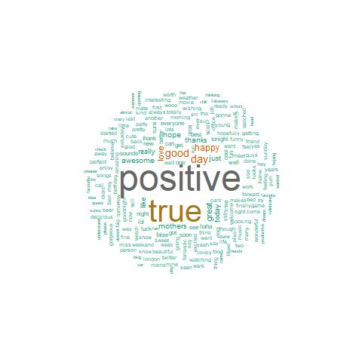
Data insights as MVP

Slide 9

Data challenges
Language Detection
Sarcasm
Language | Frequency
English | 78%
Mismatch | 22%
Tweet Size
Grammar

Slide 10
where next?
Business Motivation
MVP
Identifiable technical challenges
x Funding for further modeling and software development over 10 weeks

